Slide 1
Tutorial 6: oct 19
Project Stuff

Slide 2
3d Graphics
mesh mesh_name(“file.x”)
draw_XYZ(length) //axis
mesh_name.draw(Px,Py,Pz,yaw,pitch,roll); //where all angles are in Radians
scale=0.1;

Slide 3
Draw_3d_graphics
The way he has it set-up is that the draw_3D_graphics() functions is constantly being called.
You can do it that way too, but then all your variables have to be static.
You can also create an infinite while loop inside draw_3D_graphics() which runs all your code. That would mean draw_3D_graphics() only gets called once so your variables don’t have to be static.
You have to draw everything every frame or they will disappear for that frame, you cant decide to have one object drawn every other frame or it will disappear and reappear

Slide 4
Q1:Ship class
M - the mass of the ship
Type - a C-string variable indicating the type of the ship (eg viper).
P - an array that holds the 3D position of the ship
V - an array that holds the 3D velocity of the ship
F - an array that holds the 3D net force on the ship
A - an array that holds the 3D acceleration of the ship
double P[3+1],V[3+1],F[3+1],A[3+1];
double M;
char Type[100];
double yaw,pitch,roll;
mesh *p_mesh;
// for objects inside of objects with constructor arguments we should use dynamic object -> store using a pointer

Slide 5
Q1) ship functions
space_ship(double *P, char *file_name);
~space_ship();
void accel(); // A = F/M -> can calulate with the member variables
void draw(); // draw the mesh with the current position and orientation
double & F_e(int i); // get force component access function
void sim_step(double dt); // update the velocity/position based on A

Slide 6
Constructor
P_mesh = new mesh(filename)
mesh(filename) is the constructor for mesh

Slide 7
Accessing private variables
To access a private variable in a class you must create a public class function. This function has the “right” to access private variables, from there you can return the variable you want, or you can function(&i) and i will be the value you are trying to access.

Slide 8
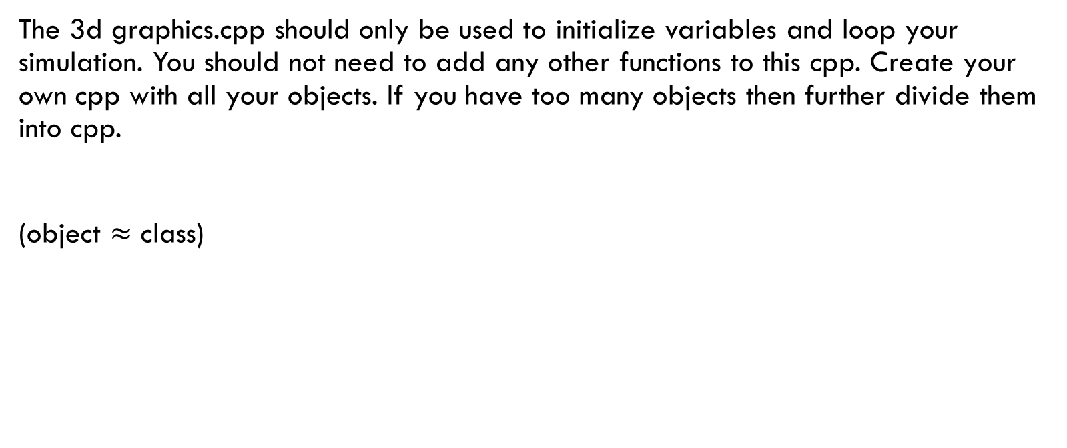
Organize your program!
The 3d graphics.cpp should only be used to initialize variables and loop your simulation. You should not need to add any other functions to this cpp. Create your own cpp with all your objects. If you have too many objects then further divide them into cpp.
(object $≈$ class)

Slide 9
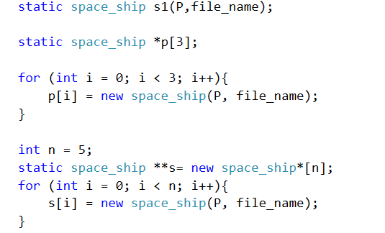
Q7 / q8

Slide 11
Project Template
Define Inputs & initial conditions
Define State Variables
Define user interaction
How will the user be able to influence the program?
Define coordinate system
Local (with respect to the object)
Global (with respect to the program)
Create a class for every object
Will contain parameters
Coordinates
mesh
Create a function that updates State Variables
Create Function that Reads inputs
You want this function to be called often since it is possible your program is too fast and doesn’t register inputs
Create Simulation loop
Update state variables
Updates coordinates
Redraws objects on screen

Slide 12
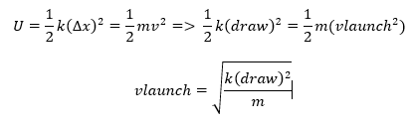

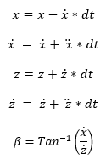
Project Example
Define Inputs
Define State Variables
Define user interaction:
Move archer
Change launch angle
Set Power
Change Gravity
Classes
World (background)
Archer
Arrow
Target
Boxes

Slide 13
Calculate Xd
double Arrow::calculate_Xd(){
//dt is constant double in main program
//Unpacking state variables
double x = X[1]; double vx = X[2];
double z = X[3]; double vz = X[4];
//Write state Equations
double xd = vx;
double xdd = (U[3])*G*M_planet*m_arrow / pow(R_planet, 2); //using actual gravity equation instead of 9.81
double zd = vz;
double zdd = (U[4])*G*M_planet*m_arrow / pow(R_planet, 2);
//pack the state derivation vector
Xd[1] = xd; Xd[2] = xdd; Xd[3] = zd; Xd[4] = zdd;
return 0;}
Although unpacking and packing variables is not necessary when actually programming, Its better to follow his example so it makes his life easier, making your grade better ☺

Slide 14
Eulers
void Arrow::eulers() {
//calculate_Xd(X[], dt, Xd[], U[]);
X[1] = X[1] + Xd[1] * dt;
if (X[2] < -200) X[2] = -200;
else if (X[2] > 200) X[2] = 200;
Else {X[2] = X[2] + Xd[2] * dt;}
X[3] = X[3] + Xd[3] * dt;
if (X[4] > 200) X[4] = 200;
else if (X[4] < -200) X[4] = -200;
Else {X[4] = X[4] + Xd[4] * dt;}
if (X[2] > 0) Theta = (PI)-atan(X[4] / X[2]);
Else Theta = -atan(X[4] / X[2]); // check if pitch is dependent on gravity}

Slide 15
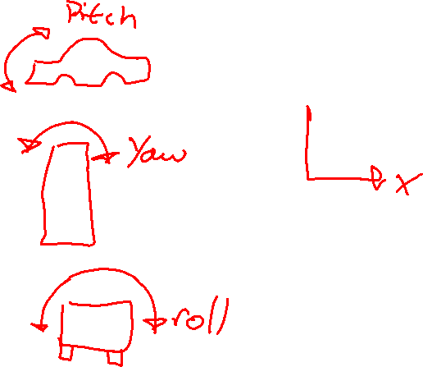
Rendering your project
archer = new mesh("Archer.x");
archer->draw(X, Y, Z, Yaw, Pitch, Roll);

Slide 16
Project Example

Slide 17
Shared Memory
Concept introduced later but easy to implement and easily boost your mark.
Basically two programs running at once and communicating with one another.
One program can run your simulation, the other can output data to csv or txt.

Slide 18
